Slide 1

CALM SOCIAL MEDIA APP
CE301 Challenge Week
Derrick Tee

Slide 2
BACKGROUND READING
Social media addiction & toxicity has become a serious problem
Social media apps trained users to be in constant need of brain stimulation, shortening attention span & reducing productivity
Social media addiction is detrimental to users not just mentally but physically as well
The effects on children who are exposed to social media at a young age while their brains are forming are even more damaging
We need to protect our next generation from such harmful behaviours & effects

Slide 3
OBJECTIVES
Create an Python web application
Create a child friendly app that do not encourage constant stimulation or toxic bahaviours
Be Profitable

Slide 4
FEATURES
The app can be used to accomplish 2 main goals
Limit the amount of time a child is on social media
Create healthy & supportive environment safe for children
True name policy which will prevent anonymity
Prevent access for users who have reached the time limits
Paid application for parents to purchase

Slide 5
FEATURES
Social Media Functions
Reduce Toxicity
Limit Access
User Profile
Creating Posts
True Name Policy
Zero Tolerance on Toxic Behaviours
Time limit allowed on app

Slide 6
IMPLEMENTATION PLAN
STEP | Week
 | 3 | 4 | 5 | 6 | 7 | 8 | 9 | 10 | 11 | 12 | 13 | 14 | 15 | 16 | 17 | 18 | 19 | 20 | 21 | 22 | 23 | 24 | 25 | 26 | 27 | 28 | 29 | 30 | 31 | 32
User Profile
Creating Posts
True Name Policy
Punishments
Time Limit
App Purchase

Slide 7
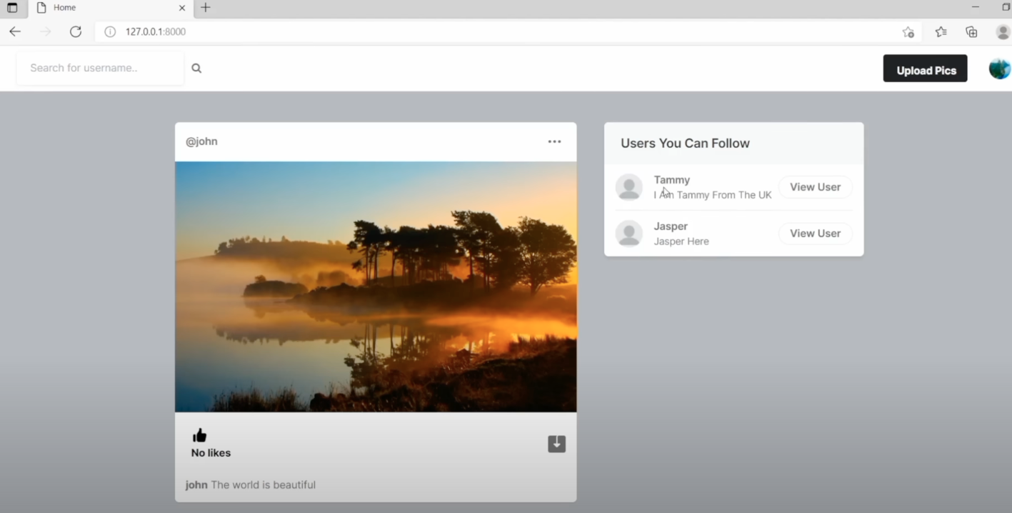
WORK DONE
Developed a base social media template
Ability to follow/unfollow
Create Posts
Like & Comment

Slide 8
BACKGROUND READING
BACKGROUND, what methods, what conclusion

